Slide 1

Hustle AI Tools: Empowering Kenyan Entrepreneurs
Hustle AI Tools is designed to empower Kenyan hustlers with smart poster and flier design automation. Many small business owners lack the design skills or budget to hire professionals, resulting in time-consuming and often poor-quality marketing materials. Our AI-powered tool offers a quick, affordable, and localized solution for creating professional visuals, helping hustlers compete effectively in the digital marketplace. This document outlines the problem, solution, product features, market opportunity, competitive advantages, project traction, and business model of Hustle AI Tools, aiming to demonstrate its potential for investors.

Slide 2
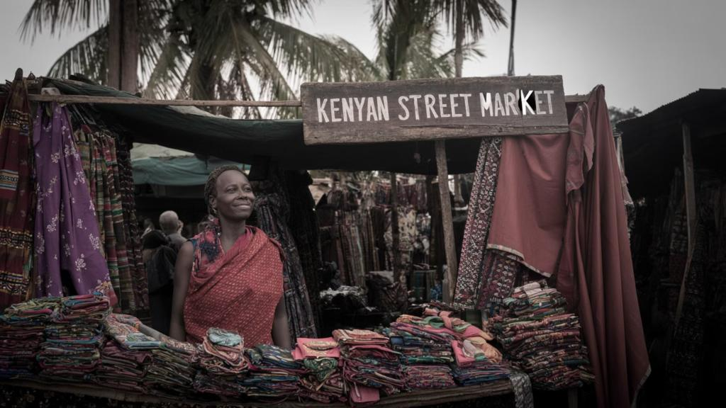
The Challenge: Design Deficit Among Kenyan Hustlers
Many small business owners in Kenya face significant challenges in creating effective marketing materials. Lacking the necessary design skills or the financial resources to hire professional designers, these entrepreneurs often struggle to produce visually appealing posters and fliers. This design deficit leads to several problems:
Many small business owners lack design skills or the budget to hire professionals.
Creating posters/fliers is time-consuming and often results in poor quality.
Hustlers rely on social media but lack polished visuals to compete effectively.
The inability to create compelling visuals hinders their ability to attract customers, build brand awareness, and ultimately, grow their businesses.

Slide 3
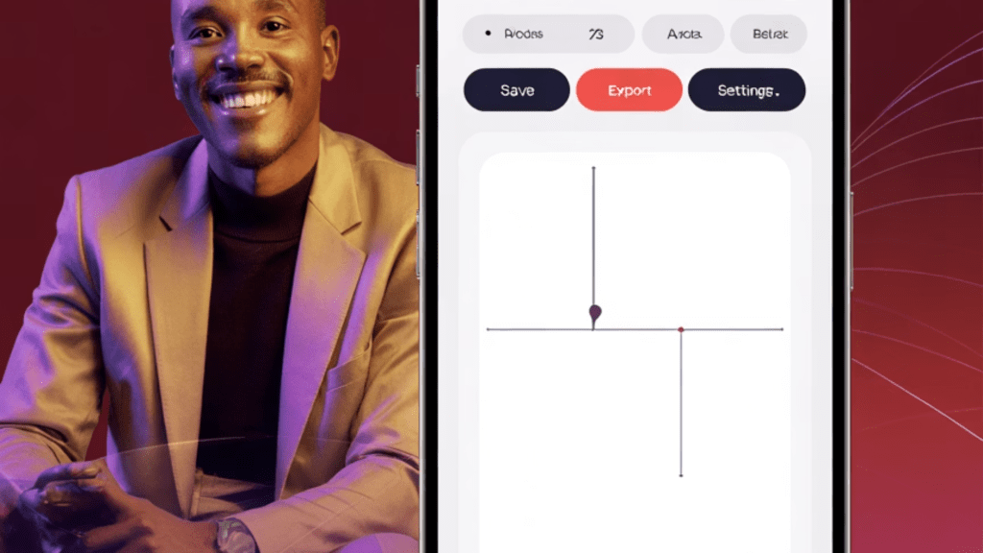
Our Solution: AI-Powered Design Automation
Hustle AI Tools offers a smart, affordable solution designed specifically for the needs of Kenyan hustlers. Our AI-powered tool automates the poster and flier creation process, allowing users to generate professional-quality visuals quickly and easily. Key features of our solution include:
AI-powered tool for quick poster/flier creation.
No design skills needed.
Affordable pricing plans tailored for hustlers.
Mobile-first user experience optimized for smartphones.
Localized templates and content relevant to the Kenyan market.

Slide 4
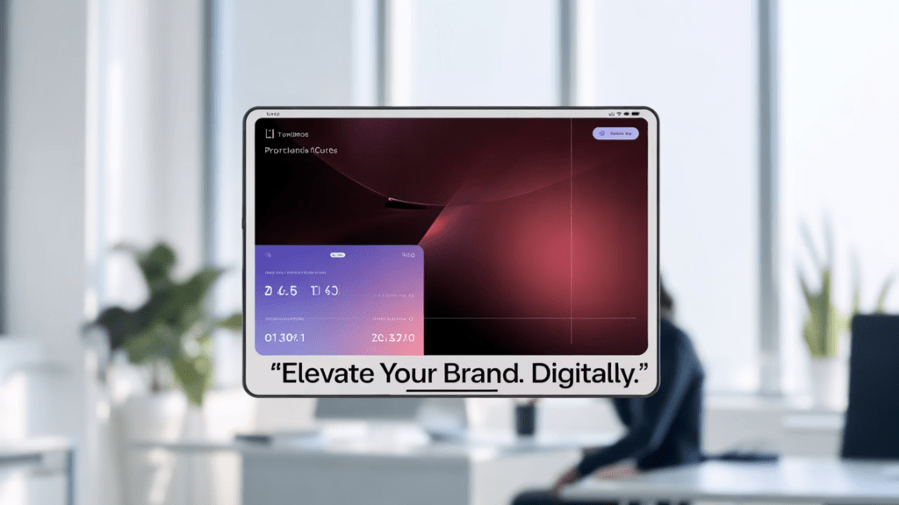
Product Features: Quick and Easy Poster Creation
Hustle AI Tools simplifies the poster and flier creation process into a few easy steps:
Choose a template: Select from a variety of templates designed for different purposes such as sales, events, and promotions.
Fill in information: Enter essential details such as business name, product/service description, pricing, and contact information.
AI generates branded poster: Our AI algorithms automatically create a professional-looking poster or flier based on the provided information and selected template.
Download & share instantly: Download the generated design and share it directly on social media platforms or print it for physical distribution.
This streamlined process ensures that even users with no design experience can create effective marketing materials in minutes.

Slide 5

Key Statistics: The Untapped Potential of the Hustler Market
Several key statistics highlight the immense opportunity for Hustle AI Tools in the Kenyan market:
2/5
95%
123M+
Business Failures
Smartphone Adoption
African Gig Workers
Small businesses that fail due to poor marketing.
Hustlers who use smartphones & WhatsApp for business.
Gig workers in Africa who need visual marketing tools.
These figures underscore the significant need for affordable, accessible marketing solutions among Kenyan hustlers, positioning Hustle AI Tools for rapid growth and impact.

Slide 6
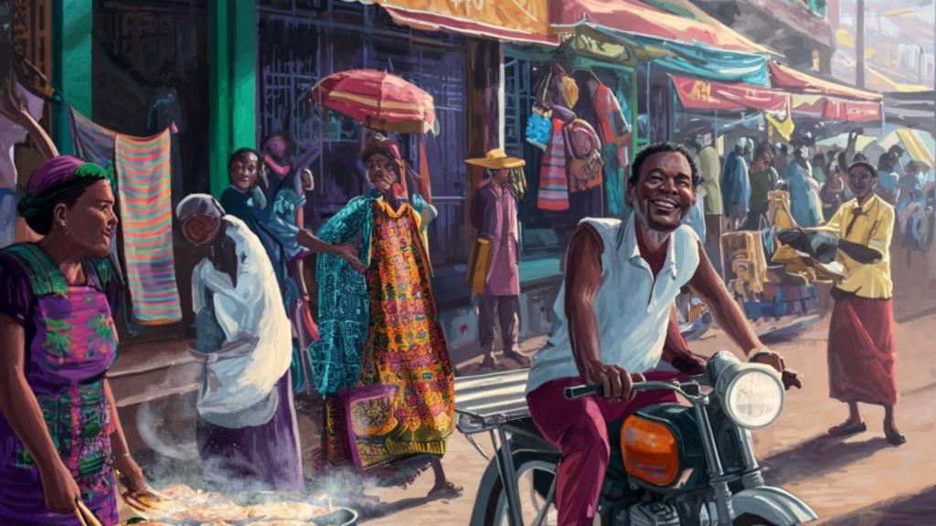










Target Market: Kenyan Micro-Entrepreneurs
Hustle AI Tools targets a diverse range of micro-entrepreneurs in Kenya, including:
Bodaboda Operators
Small Vendors
20% of target market
20% of target market
Event Promoters
20% of target market
Online Resellers
20% of target market
Food Sellers
20% of target market
With a total market size of over 5 million micro-entrepreneurs in Kenya, Hustle AI Tools has a substantial opportunity to serve a large and growing customer base.

Slide 7

Competitive Landscape: Differentiation Through Localization
While competitors like Canva, Adobe Express, and PosterMyWall offer similar design tools, Hustle AI Tools differentiates itself through:
Localized templates: Designs tailored to Kenyan cultural and business contexts.
Mobile-first UX: Optimized user experience for smartphone users.
Swahili-friendly interface: Support for the Swahili language, making the tool more accessible to local users.
Hustler pricing: Affordable subscription plans designed to fit the budgets of micro-entrepreneurs.
By focusing on the specific needs and preferences of Kenyan hustlers, Hustle AI Tools gains a competitive edge over global competitors.

Slide 8
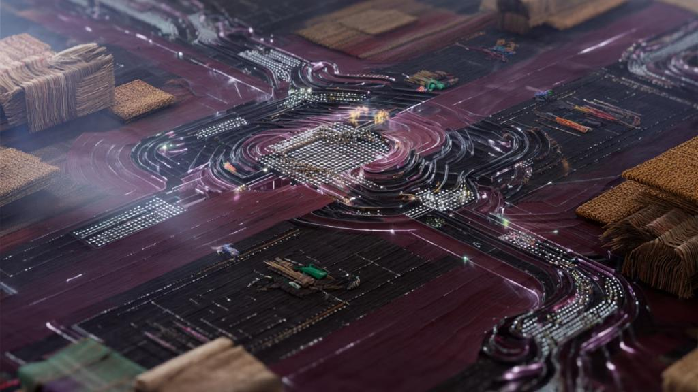
Competitive Advantages: AI-Powered and User-Centric
Hustle AI Tools offers several key competitive advantages:
AI auto-fill and layout: Intelligent algorithms that automatically populate designs with relevant information and arrange elements for optimal visual impact.
Hustler-specific templates: A curated library of templates designed specifically for the needs of Kenyan micro-entrepreneurs.
Low-data use: Optimized for efficient data usage, ensuring accessibility for users with limited internet connectivity.
Offline support (coming soon): Future functionality that will allow users to create and edit designs even without an internet connection.
These advantages position Hustle AI Tools as the go-to design solution for Kenyan hustlers.

Slide 9

Project Traction: Building Momentum Through User Feedback
Our project has achieved significant traction in a short period:
Month 1
1
MVP Development
2
Month 2
Supabase + AI Integration
Month 3
3
Beta Test (50 Users)
4
Month 4
UGC + Feedback Collection
Month 5
5
Scale & Partner
Through iterative development and user feedback, we are continuously improving Hustle AI Tools to meet the evolving needs of our target market. These milestones demonstrate our commitment to delivering a high-quality product that resonates with Kenyan hustlers.

Slide 10

Business Model: Sustainable Growth and Revenue Streams
Freemium Access
Affordable Premium Tier
Attract a broad user base with a free, feature-rich version, driving initial adoption and awareness.
Unlock advanced features and expanded capabilities with a low-cost subscription (KES 50–100).
Group Subscriptions
Sponsored Templates
Cater to Jua Kali groups with discounted bulk subscriptions, fostering community and collaboration.
Monetize popular templates through brand sponsorships, offering targeted advertising opportunities.

Slide 11



Go-To-Market Strategy: Reaching Kenyan Hustlers
Our go-to-market strategy focuses on direct engagement with Kenyan micro-entrepreneurs through:
Social Media & WhatsApp Campaigns
Partnerships with Jua Kali & Boda Groups
Campus Ambassadors & PLP Rollout
Targeted ads and content on platforms frequented by our target demographic. Leverage WhatsApp for direct outreach and community building.
Collaborate with influential associations to offer Hustle AI Tools as a value-added service to their members.
Engage university students as brand ambassadors. Offer a "Poster-Like-a-Pro" (PLP) package to jumpstart adoption.

Slide 12

Social Impact: Empowering Communities and Driving Change
Hustle AI Tools is more than just a design platform; it's a catalyst for positive social change in Kenya. We address critical needs and contribute to sustainable development goals by:
Promoting Digital Inclusion: Providing accessible design tools levels the playing field for micro-entrepreneurs.
Empowering Youth: Equipping young Kenyans with valuable skills and resources.
Supporting SDG 8 & 9: Contributing to decent work, economic growth, innovation, and infrastructure development.
Enhancing Branding Skills: Fostering creativity and design acumen within the hustler community.

Slide 13

Our Ask: Partnering for Progress
We're seeking KES 200,000 ($1,500) in seed funding to fuel our launch and initial growth. This investment will enable us to:
Finalize development and rigorously test our platform.
Run a targeted pilot program with Jua Kali entrepreneurs.
Secure reliable hosting infrastructure for seamless user experience.
Beyond funding, we value mentorship and marketing support to amplify our reach and impact.

Slide 14

Our Team: The Visionaries Behind Hustle AI
Jefther Simeon Afuyo
Lead Developer & Designer. Passionate about empowering Kenyan entrepreneurs through innovative technology. Possesses deep expertise in AI, design, and software development.
We're actively seeking talented collaborators to join our mission. If you're passionate about marketing, UX design, or community engagement, we'd love to hear from you!

Slide 15
Thank You!
📧 afuyojefther@gmail.com
📱 +254 796 090 806
🌍 github.com/Jefther37/hustle-ai-tools
We are excited to partner with you to empower Kenyan entrepreneurs!

